Slide 1

Math behind Neural Networks

Slide 2
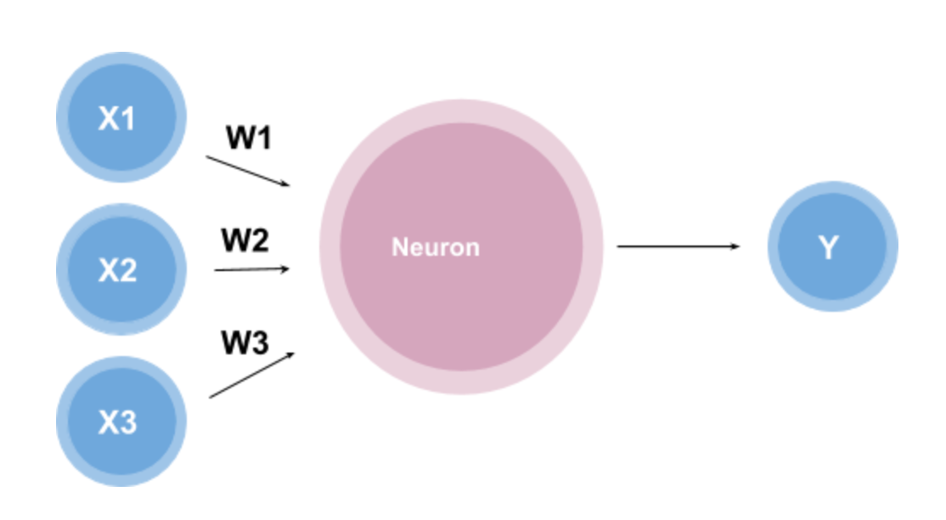
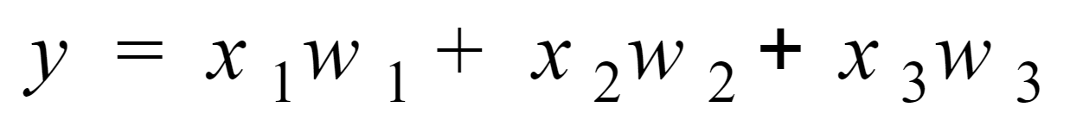
Perceptron
Assume we have a single neuron and three inputs x1, x2, x3 multiplied by the weights w1, w2, w3 respectively as shown below,

Slide 3
Activation Function
This function is called the weighted sum because it is the sum of the weights and inputs.
This looks like a good function, but what if we wanted the outputs to fall into a certain range say 0 to 1.
We can do this by using something known as an activation function.
An activation function is a function that converts the input given (the input, in this case, would be the weighted sum) into a certain output based on a set of rules.

Slide 4
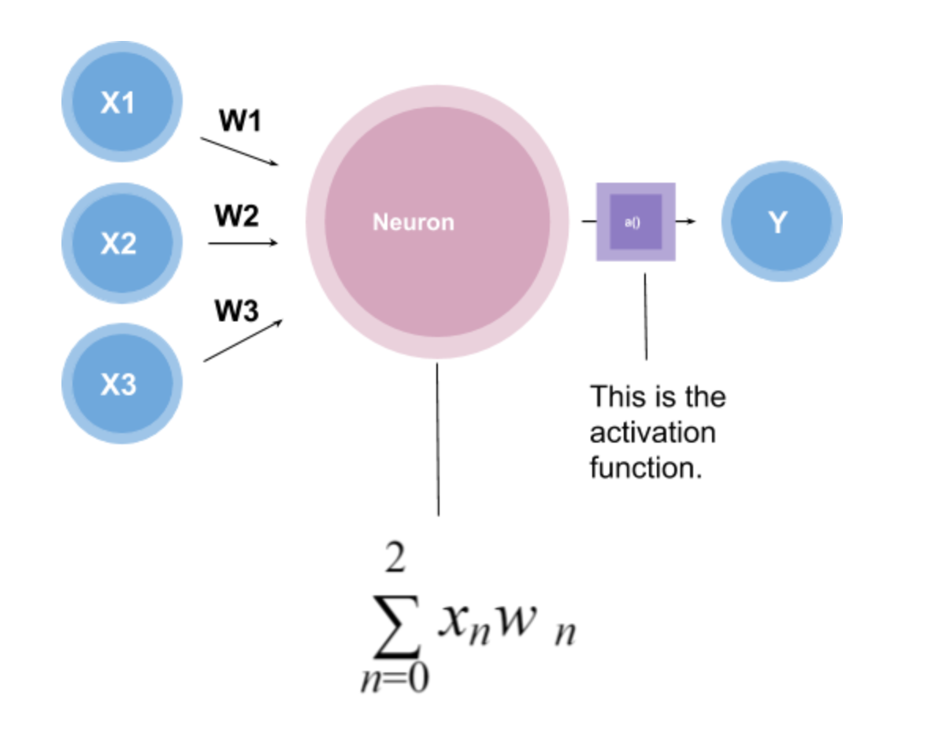
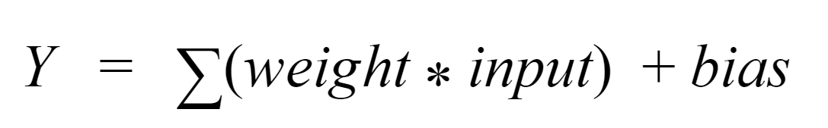
Activation Function
Hyperbolic Tangent: used to output a number from -1 to 1.
Logistic Function: used to output a number from 0 to 1.
Tanh
ReLU

Slide 5
Neural Network
Neural network is the network on multiple perceptrons in multiple layers.
Artificial neural networks (ANNs) are comprised of a node layers, containing an input layer, one or more hidden layers, and an output layer.
Each node, or artificial neuron, connects to another and has an associated weight and threshold.

Slide 6
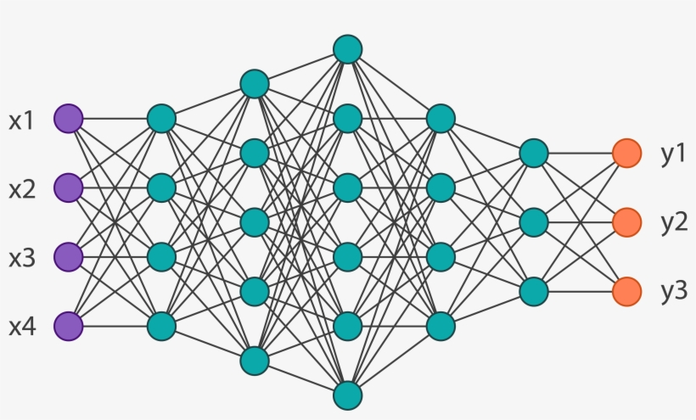
Feedforward Neural Network
Signals are propagated only in the forward direction.

Slide 7
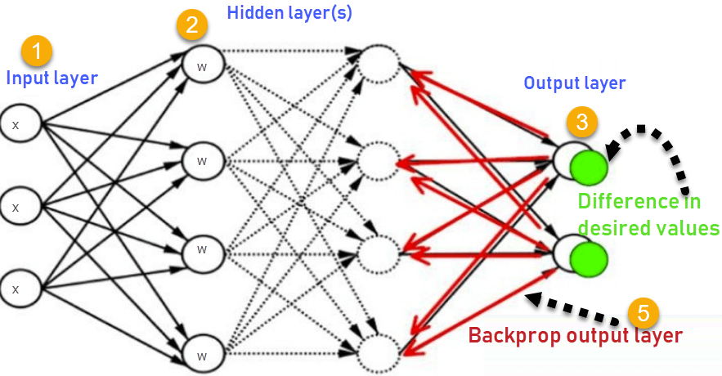
Back propagation
Error is calculated at the output.
The error is propagated back to the input and weights are changed.

Slide 8
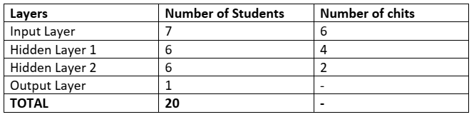
Lab activity
Ask 20 students to make a neural network and let them pass some chits to understand how NN works.

